Slide 1
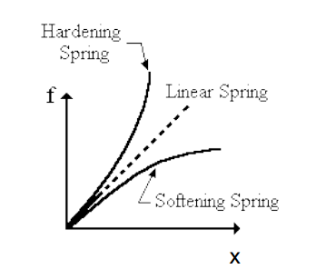
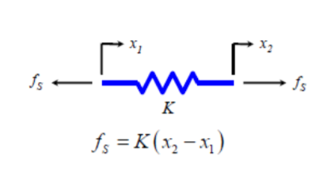
MODELING SIMPLE MECHANICAL ELEMENTS: SPRINGS
Springs are stiffness elements used to store and release potential energy
Assume the spring is ideal; i.e. ignoring its mass and assume zero damping and linear behavior
In real life, springs are not linear.
http://www.ecs.csun.edu/~nhuttho/me584/Chapter%203%20Mechanical%20Systems_part1_forclass.pdf

Slide 2
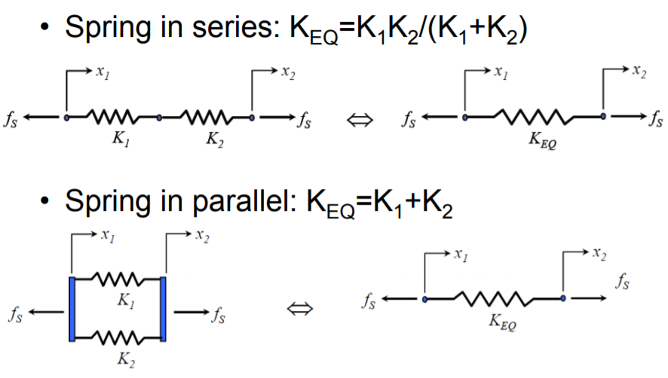
MODELING SIMPLE MECHANICAL ELEMENTS: SPRINGS IN SERIES AND PARALLEL
http://www.ecs.csun.edu/~nhuttho/me584/Chapter%203%20Mechanical%20Systems_part1_forclass.pdf

Slide 3
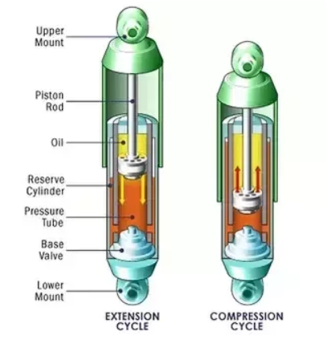
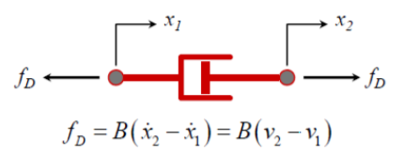
MODELING SIMPLE MECHANICAL ELEMENTS: DAMPER SYSTEMS
A damper helps to dissipate energy.
It absorbs the vibrational energy of the spring of the car.
If the car does not have a shock absorber, the vehicle would spring up and down till it lost all its energy.
The shock absorber dissipates the energy of the spring as heat energy.
http://www.ecs.csun.edu/~nhuttho/me584/Chapter%203%20Mechanical%20Systems_part1_forclass.pdf

Slide 4
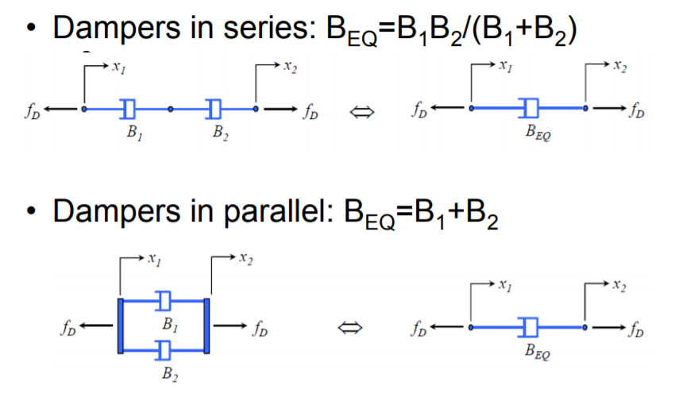
MODELING SIMPLE MECHANICAL ELEMENTS: DAMPER IN SERIES AND PARALLEL
http://www.ecs.csun.edu/~nhuttho/me584/Chapter%203%20Mechanical%20Systems_part1_forclass.pdf

Slide 5
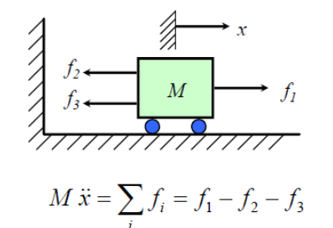
MODELING SIMPLE MECHANICAL ELEMENTS: INTERTIAL ELEMENT
Inertial elements store kinetic energy
http://www.ecs.csun.edu/~nhuttho/me584/Chapter%203%20Mechanical%20Systems_part1_forclass.pdf

Slide 6
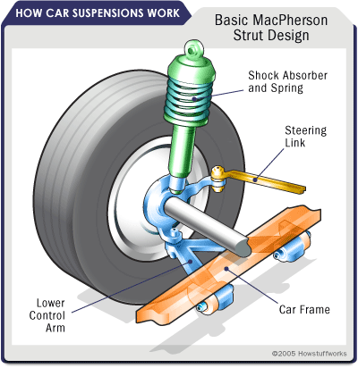
MODELING SIMPLE MECHANICAL ELEMENTS: DAMPER IN SERIES AND PARALLEL
A Strut is a shock absorber and a spring fitted into one unit.
https://auto.howstuffworks.com/car-suspension3.htm

